Slide 1
Using JetBench to Evaluate the Efficiency of Multiprocessor Support for Parallel Processing
HaiTao Mei and Andy Wellings
Department of Computer Science
University of York, UK

Slide 2
Goal of the Work
To compare how efficiently the concurrency models of various programming languages are implemented on multiprocessor SMP systems
Given a program running on Linux/Windows does it really matter what language you use?
Evaluate
Ada, C (+ OMP), RTSJ (Jamaica) ― with compiled implementations
C#, Java, Java with Thread Pools, Java with JOMP ― with JIT implementations
Notes:
The languages have been chosen as they all support the shared memory model of computation. We use a mixture of languages that have been used in the real-time embedded systems domain and those that have not.

Slide 3
Approach
Use JetBench
an application benchmark written in C used in conjunction with OpenMP
contains real time jet engine thermodynamic calculations
calculations are inspired by a sequential application named NASA EngineSim
simple parallel program
Rewrite JetBench in
Ada, C (+ OMP), RTSJ (Jamaica)
C#, Java, Java with Thread Pools, Java with JOMP

Slide 4
Approach continued
Use Linux
on a physical machine (1 – 8 cores)
via the Simics simulator (1-128 cores)
Measure response times and speed-ups
Use statistical techniques to evaluate the significance of the results

Slide 5
JetBench
Goals:
to be a benchmark that can execute in parallel on multiprocessor platforms
to provide a tool to analyze real time performance of a real-time operating system, including thread scheduling, execution efficiency and memory management capabilities
3 step execution
initialization
create threads with the help of OpenMP and carry out the calculation in parallel
print out results

Slide 6
JetBench: Step 1
Initializes parameters and opens a file that contains all the input data needed
The input data consists of the values of three sensors: altitude, air speed, and throttle.
A fourth input value gives a contrived deadline that represents a time constraint on the calculation of the engine's performance figures
The deadline is fixed at a value of 0.05 seconds
This has been chosen to be approximately 2-3 times the value of the execution time of the raw C code calculations
Hence, the required utilization is less than 50%

Slide 7
JetBench: Step 2
Creates and starts one worker thread for each processing core
All the threads perform the same operations
Each thread calculates π
Then reads input data and carries out thermodynamic, geometry and engine performance calculations
The times taken to perform the calculations are recorded
When all the data is processed, the threads terminate

Slide 8
JetBench: Step 3
During the last step, the results are collected from the second step and are printed

Slide 9
Issues with JetBench
Code is littered with needless access to shared variables and never-used variables
Race conditions — no use of synchronization when shared variables are needed
Confuses response times with execution time
Ignores thread creation and termination overheads

Slide 10
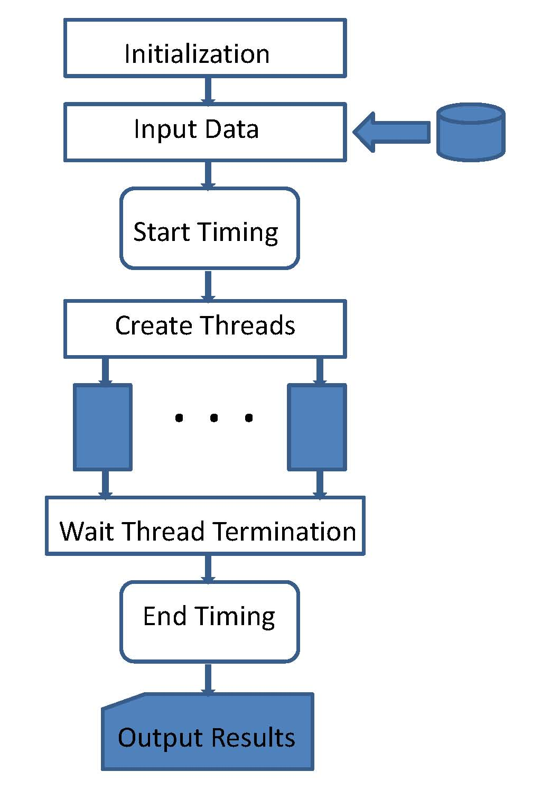
Revised structure
Notes:
Read data into array first
Remove unreferenced variables
Copy variable to thread local

Slide 11
Languages
Ada
AdaCore GNAT GPL 4.6
C used with OMP
gcc 4.8.2 and OpenMP 3.1
Java 8
Java version 1.8.0_05 (build 1.8.0_05-b13)
Java using Open MP
jomp1.0b.
RTSJ
Jamaica Builder 6.2 Release 4 (build 8016).
C#
Mono JIT compiler version 3.2.8.

Slide 12
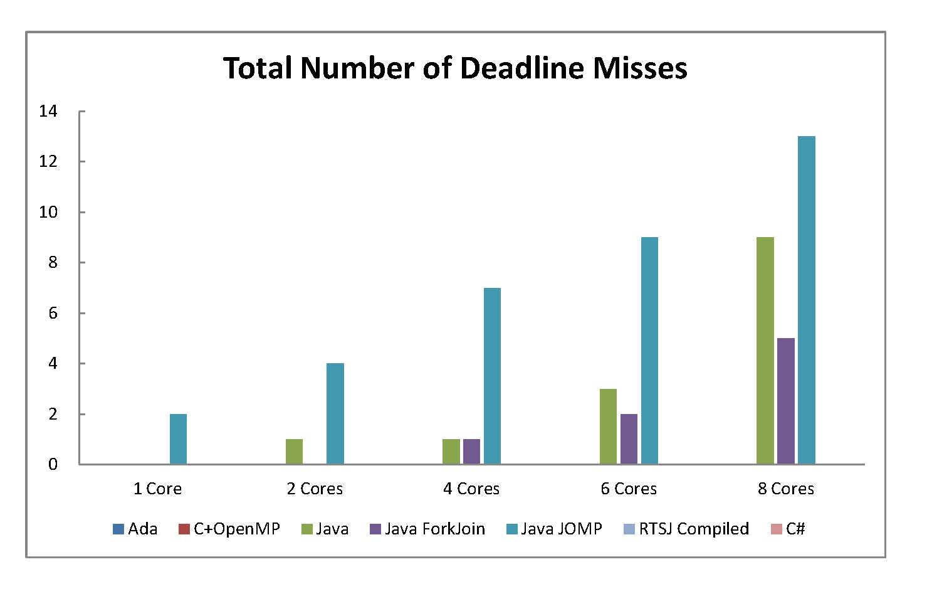
Results I

Slide 13
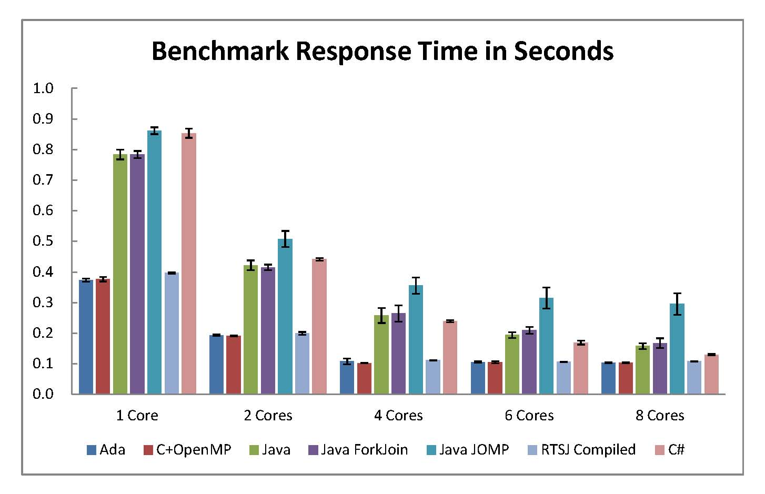
Results: II

Slide 14
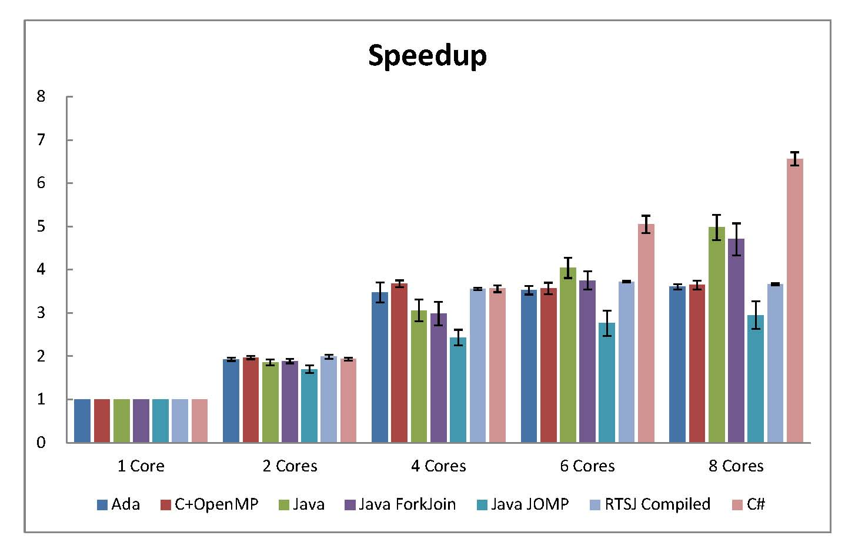
Results: III

Slide 15
Analysis of Results
Analysis of variance (ANOVA) is a general statistical technique for separating the total variation in a set of measurements into
the variation due to measurement noise and the
variation due to real differences among the alternatives being compared

Slide 16
Two-way ANOVA
Examines the influence of two different independent variables on one dependent variable
It determines both the main effect of contributions of each independent variable and if there is an interaction effect between them
The analysis computes an F value which describes this relationship
It is an appropriate technique for the analysis of the measurements of execution/response times

Slide 17
Goals of analysis
To prove that both programming languages and the number of cores have an impact on the benchmark's response times,
and also that there is significant interaction between them,
i.e. different programming languages have different efficiency impacts in multiprocessor parallel processing
The null hypothesis is made that both factors (programming languages and number of cores) have no effect on the benchmark's response times, i.e. its efficiency

Slide 18
ANOVA Analysis
Source | F | Probability of null hypothesis | F value for 0.01 probability of null hypothesis
Cores | 41650.41 | < 0.01 | 3.48
Languages | 10576.99 | < 0.01 | 2.956
Interaction | 914.45 | < 0.01 | 1.791
Calculations performed by Matlab
Of course, this doesn’t tell us much.
It could be one bad implementation, e.g. Java JOMP!

Slide 19
Tukey HSD Analysis
Compares the means of every language with the means of every other language to find significant differences
A >> B indicates the means are significantly different and A is larger than B
A > B indicates the means are NOT significantly different but A is larger than B
Matlab used to perform calculations

Slide 20
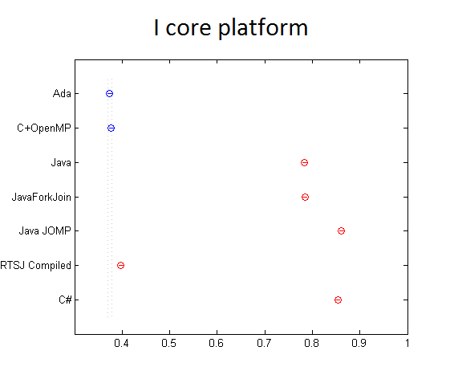
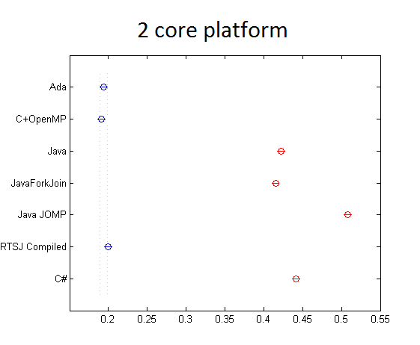
Response Times: 1 and 2 Cores
Java JOMP >> C# >> Java ForkJoin > Java >> RTSJ >> C + OpenMP > Ada
Java JOMP >> C# >> Java > Java ForkJoin >> RTSJ > Ada > C + OpenMP

Slide 21
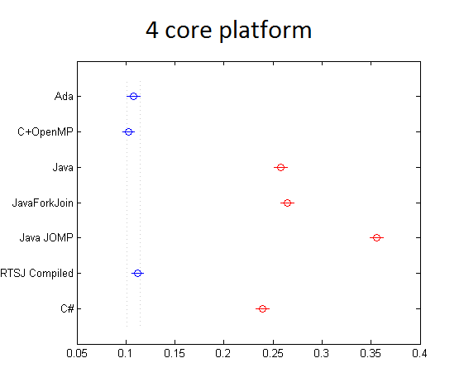
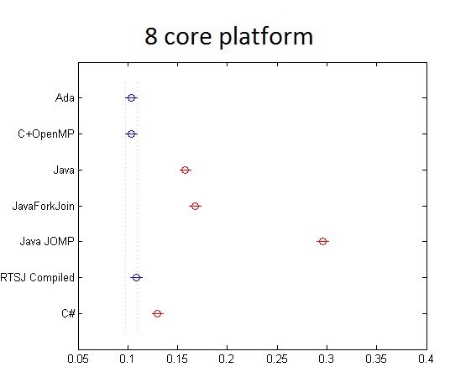
Response Times: 4 and 8 Cores

Slide 22
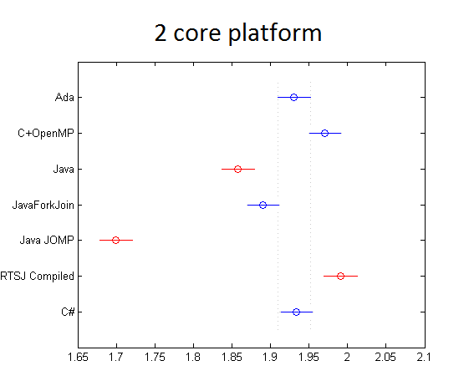
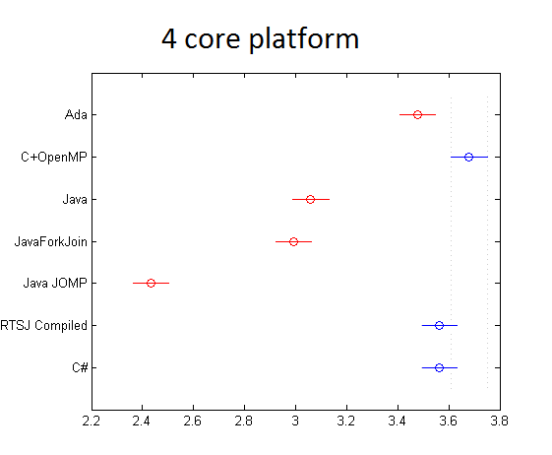
Speed-UP: 2 and 4 Cores
RTSJ > C+OpenMP > C# > Ada >
Java ForkJoin >
Java >> Java JOMP
C+OpenMP > C# > RTSJ > Ada >> Java >
Java ForkJoin >> Java JOMP

Slide 23
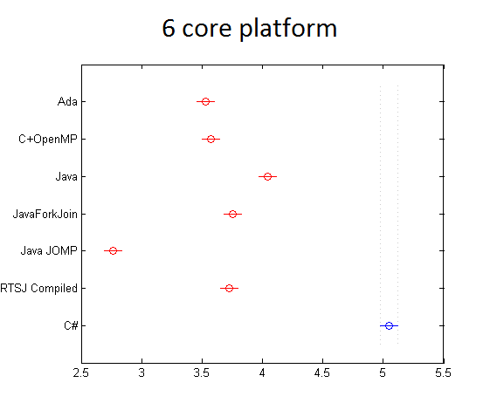
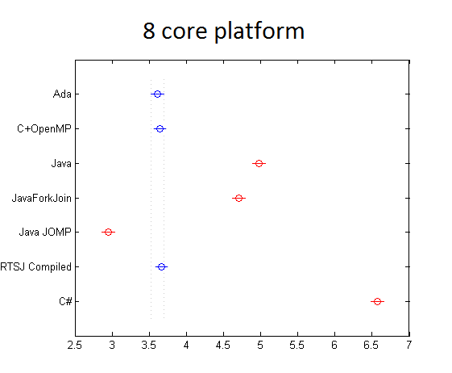
Speed-UP: 6 and 8 Cores
Impact of hyperthreading?

Slide 24
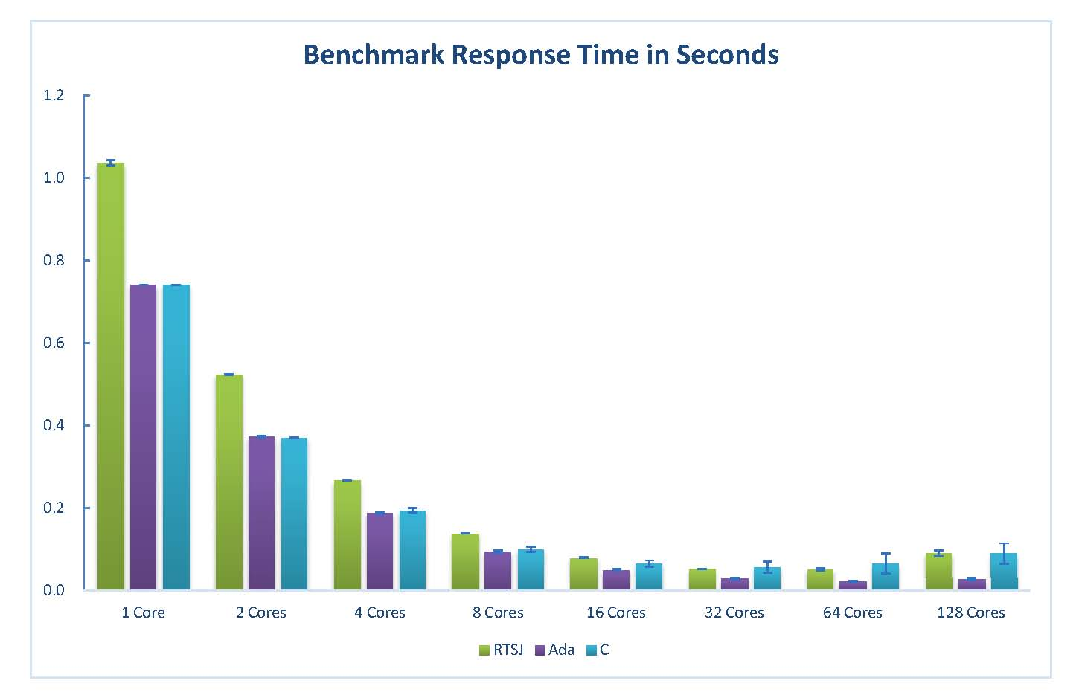
Response Times using Simics
Notes:
This is because the size of the data set is 128! Hence the overheads of thread creations has more impact

Slide 25
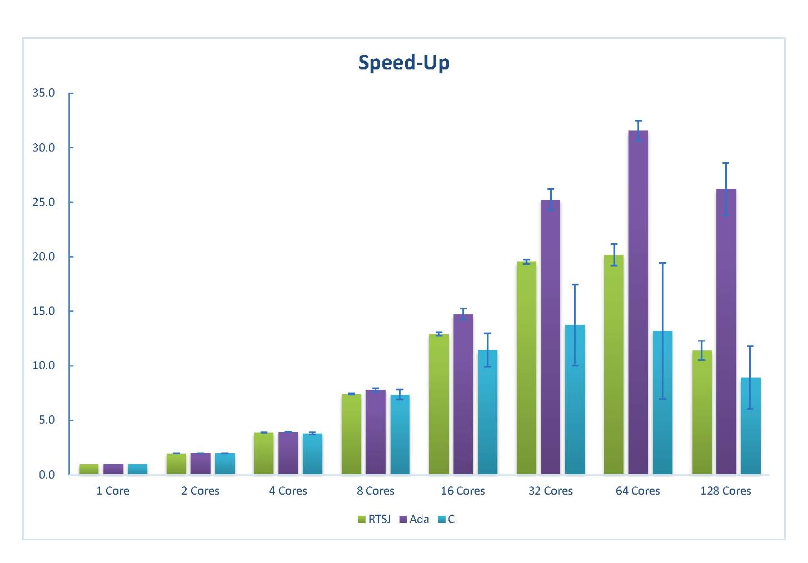
Speed-Up using Simics

Slide 26
Conclusions
It now taken for granted that real-time and embedded platforms will be multicore
Plethora of programming languages can be used
We chose some languages targeting real-time and others (that tend to be JITted)
Even allowing a warm up phase, JIT couldn’t match compiled code
Thread creation cost becomes more significant if not processing lots of input data

