Slide 1
Real-Time Sensing on Android
Reliable Mobile Systems Group
Fiji Systems Inc.
Yin Yan, Shaun Cosgrove, Ethan Blanton, Steven Y. Ko, Lukasz Ziarek
Notes:
Inconsistent in jpapaben
Introduction: …
This is a part of the RTDroid system, that we currently building in our reliable mobile system group.
RTdroid is a real-time system with Android compatibility.
The reason that we want to build such a real-time system is there are lots of interest have raised in adopting Android with real-time usage.

Slide 2
Interest in Real-Time Android
Evaluating Android OS for Embedded Real-Time
Systems
Android and RTOS together:
The dynamic duo for today’s medical devices
RTAndroid:
  A real-time extension to Android with non-blocking GC
RTDroid:
  RTOS + RTVM + RT-Android Framework
Notes:
There is an previous publication that evaluate using Android for embedded real-time system, and proposed different system architectures to make android real-time.
Similarly, in health industry, ….
RTAndroid: a real-time extension to android platform with non-blocking gc
The reason that we chose to tackle the sensor architecture first instead of the other components.
Because since first android release on 2009, its build-in sensor architecture have been attracted lots of people’s attention.
There are a number of mobile apps are sensor event-driven.

Slide 3
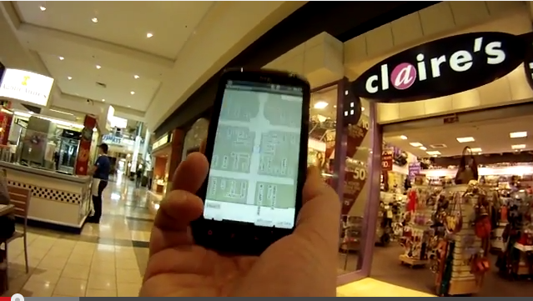
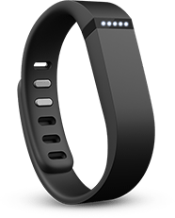
Sensor Event Driven Apps in Mobile
Indoor Positioning
  Inertial sensor data
  Bluetooth
  GSM
  Wireless Lan
Wearable
  Tracking activity
  Sleeping quality
  Daily calorie consumption
Notes:
There is an previous publication that evaluate using Android for embedded real-time system, and proposed different system architectures to make android real-time.
Similarly, in health industry, ….
RTAndroid: a real-time extension to android platform with non-blocking gc
The reason that we chose to tackle the sensor architecture first instead of the other components.
Because since first android release on 2009, its build-in sensor architecture have been attracted lots of people’s attention.
There are a number of mobile apps are sensor event-driven.

Slide 4
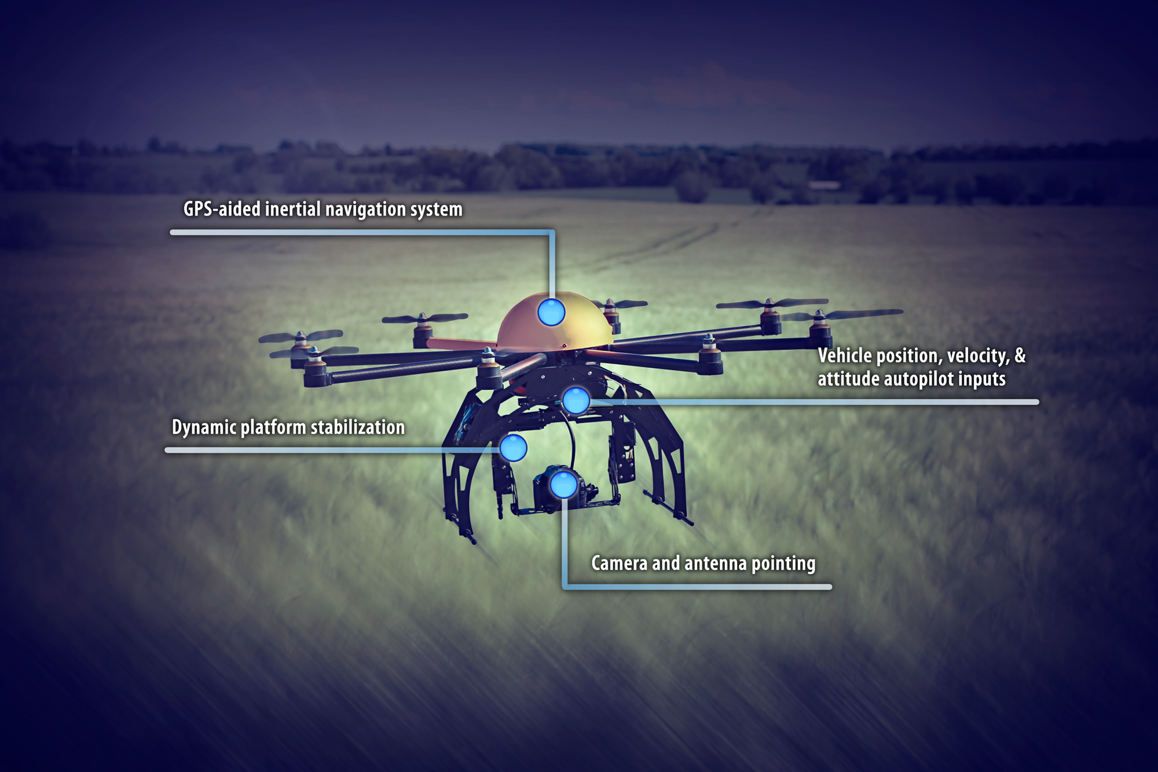
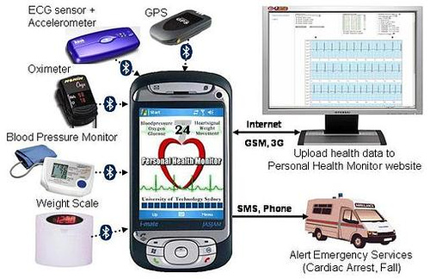
Sensor Event Driven Apps in Real-time
GPS
inertial
measurement unit
Stabilization
Camera and antenna pointing
Notes:
There is an previous publication that evaluate using Android for embedded real-time system, and proposed different system architectures to make android real-time.
Similarly, in health industry, ….
RTAndroid: a real-time extension to android platform with non-blocking gc
The reason that we chose to tackle the sensor architecture first instead of the other components.
Because since first android release on 2009, its build-in sensor architecture have been attracted lots of people’s attention.
There are a number of mobile apps are sensor event-driven.

Slide 5
Requirement for Sensor Architecture
Traditional mobile sensing app
  Multi sensors
  Multi components
  Hardware control
Real-time sensing app
  Predictability in data delivery
Notes:
Magne’tometer

Slide 6
Available Sensors in Android
Hardware sensor
  Accelerometer
  Ambient temperature
  Geomagnetic field
  Gyroscope
  Light
  Pressure
  Humidity
Software Sensors
  Linear acceleration
  Significant motion
  Step detector
  Step counter
  Rotation sensor
  Game rotation vector
  Gravity
  Magnetometer
  Orientation
  …
Notes:
Magne’tometer

Slide 7
What Does the Android Sensor Architecture Provide?
Application
Sensor Manager
enable/disable
Accelerometer
SensorEvent
Listener
Change sampling
rate
Gyroscope
Subscript
sensor event
…
Magnetometer
Notes:
We will get a closer look at the SensorManger for each layer, and explain why it is not suitable for Real-time.
In Kernel, the handler hardware interruption, read & buffer the sensor raw value into /dev file system.
Unbound time for delivery.

Slide 8
How Does Android Sensor Manager Work?
Input
Event
HAL
Sensor
Service
Sensor
Manger
Sensor
Event
Listener
Sensor
Thread
Native
SensorManger
Sensor
Fusion
Sensor
Thread
Event
Queue
Kernel
System
Runtime
Framework
Application
Notes:
We will get a closer look at the SensorManger for each layer, and explain why it is not suitable for Real-time.
In Kernel, the handler hardware interruption, read & buffer the sensor raw value into /dev file system.
Unbound time for delivery.

Slide 9
What Happens In a Real-Time Context?
One application is listening on two sensors
  Accelerometer with higher priority
  Gyroscope with lower priority
Application
Android Framework
Kernel
Accelerometer Data
Gyroscope Data
Unbound Delivery Time
Notes:
The lock contention between task requires higher-priority data and task requires lower priority-data, and these contentions can be presented in both app as well as in framework

Slide 10
RT SensorManager
Event-driven architecture
  Polling and processing thread
Receiver-based priority inheritance
  Polling and processing inherit the highest priority of the receivers
  RT-Handler for delivery sensor events with to different receivers
Notes:
Make into two slides

Slide 11
RT SensorManager
Polling
Threads
Processing
Threads
RT-Handler
Apps
P₁
P₁
P₁
Accelerometer
Accelerometer
P₁
Accel Listener
Handler
…
gyroscope
gyroscope
Gyroscope Listener
P₂
P₂
Handler
P₂
P₂
P₁ > P₂
Notes:
Here is an example that illustrate how the rt-sensor manager works internally.
The application has the same scenario as I mentioned in previous slide.
We have two sensor listeners, one for accel with higher priority, gyro with lower priority.
In the framework, the polling and processing threads are assigned the same priority as their listeners.
After the processing threads convert the data to sensor object, it will send a message to RT-handler.
The message will be dispatched in RT-Handler separately to invoke the listener callback functions.

Slide 12
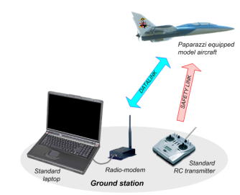
Evaluation on jPapabench

Slide 13
Porting jPapaBench into RTDroid
Fly-By-Wired (FBW)
Simulation
Autopilot
TestPPMTask
Handler
SimulatorFlight
ModelTaskHandler
Navigation
TaskHandler
SendDataTo
Autopolit
SimulatorIR
TaskHandler
AltitudeControl
TaskHandler
CheckFailsafe
TaskHandler
SimulatorGPS
TaskHandler
…
Data injection
Data subscription
CheckMega128
ValuesTaskHandler
SensorManager
Stablization
TaskHandler
Notes:
The FBW module receives commands from the ground and sends them to servos.
The Autopilot module is responsible for flying according to a given flight-plan.
And based on data from sensors it sends flying status to the FBW module.
Simulator collects information from the command, and
computes a physical model of the plane and produce sensor and GPS data
==========================================================================================================
There are two top-level modules Autopilot and FBW (fly-by-wire) connected by SPI bus.
On real hardware these modules are deployed on two different computation units.
In jPapabench, they are present in a single JVM.
The FBW module receives commands from the ground and sends them to servos.
The Autopilot module is responsible for flying according to a given flight-plan.
Based on data from sensors it sends flying status to the FBW module.
jPapaBench is deployed with third module called Simulator, which collects information from the command,
computes a physical model of the plane and produce sensor and GPS data

Slide 14
Evaluation on jPapabench
Simulated workload:
  Memory intensive load: allocating a 2.5 MB integer array every 20ms
  Computation intensive load: tight loop performing a floating point multiplication every 20ms
  Client intensive load: 1 higher priority a listener with number of lower priority listeners
Measurement:
The latency of the IR sensor data delivery
Time cost from the time of sensor data buffered to the time of the sensor data delivered in IR Sensor reading task

Slide 15
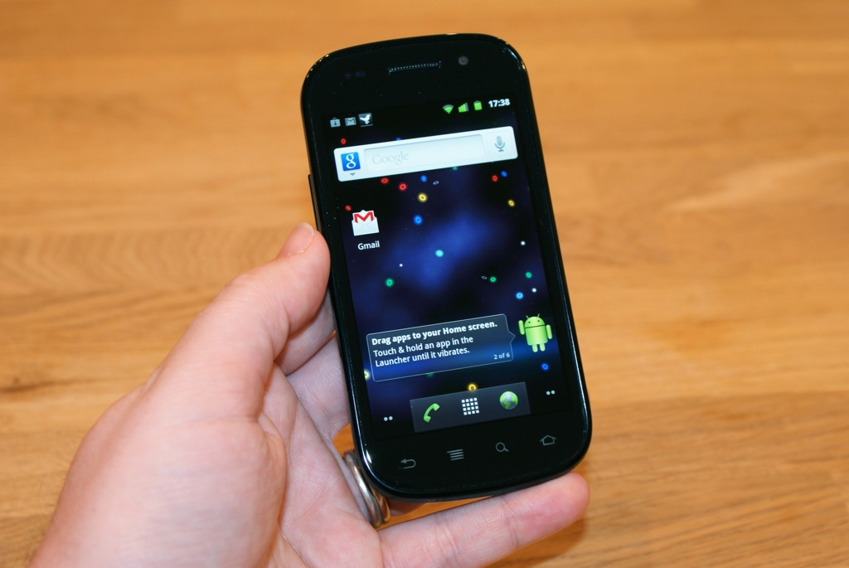
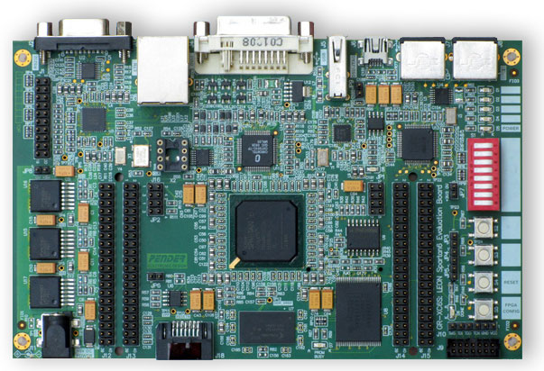
Evaluation Platforms
RT Linux
RTEMS
Soft Real-time Smartphone
  ARM Cortex-A8 1000MHz
  512 MB memory
  Android 4.1.1 on Linux 3.0 with real time patch
Hard Real-time
Embedded
  SPARC, Leon3, 50 MHz
  8MB flash PROM
  64MB SDRAM
  RTEMS 4.9.4

Slide 16
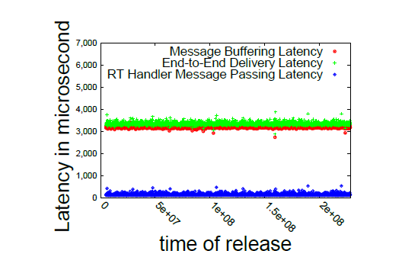
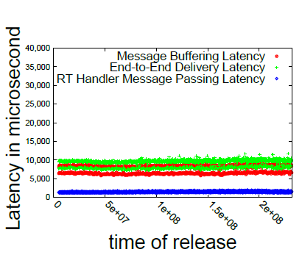
Evaluation for Java Autopilot
RTEMS
Base line performance on
Nexus S
Base line performance on LEON3
Notes:
The speration is caused by the interval between the time sensor data are injected into buffer in sensor manager, and the time the polling thread reads data.

Slide 17
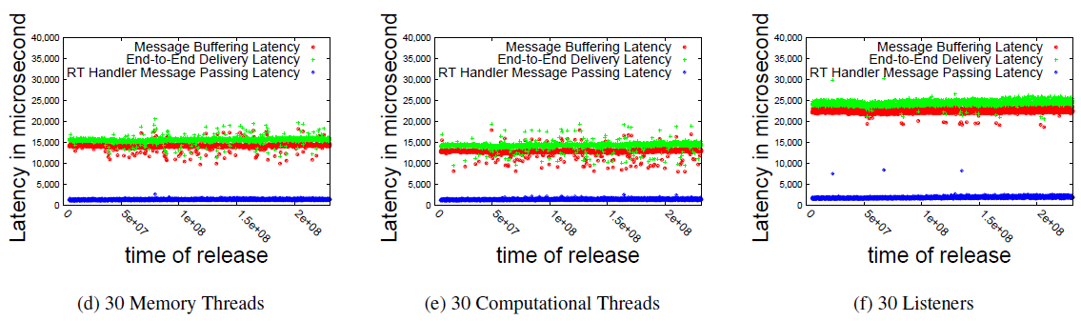
Evaluation for Java Autopilot
RTEMS
RT SensorManager stress tests on LEON3
Notes:
Message buffering dominates the overall latency,
Which means the interval between the time sensor
data are injected into buffer in sensor manager, and
the time the polling thread reads data.
Our polling thread is roughly bounded to 25ms. We
obtain a few latencies that are 30 ms in the listener extensive experiment.
This overhead is mainly additional to additionally buffering costs
as the data is replicated for each priority level and the delivered to
corresponding handlers.
The overhead is proportional to the number
of low priority listeners and is the combination of the largest
interval in polling including the preemption cost.
There is little difference between 30 memory and 30 computational threads.
There is enough slack in the system for the GC to keep up
with memory allocations performed in the memory noise generating
threads.

Slide 18
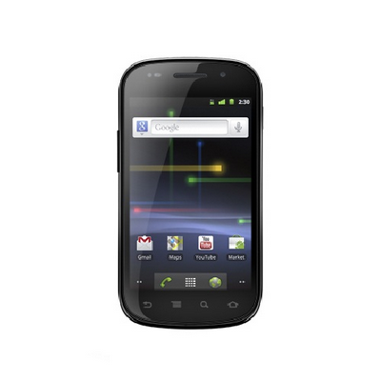

Future Extensions to jPapabench
Connect jPapabench with physical simulator
Drivers in kernel for RTDroid SensorManager
jPapabench
Application
Simulator in
Paparazzi
Sensor Manager
Kernel Driver
Flight dynamic model
IR & GPS
Notes:
reason of building the app is because some of the problems that we had discussed yesterday afternoon.
We want to have a platform both in hardware and software that we can deploy the application on the actual device.
This application is a portion of a much larger body of work to create
a fully working Java autopilot running on real world hardware device.
Unfortunatly, we are long-way off to be able to flight this, the first step is integrate it into simulator.

Slide 19
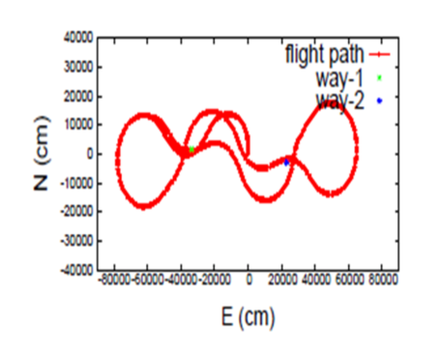
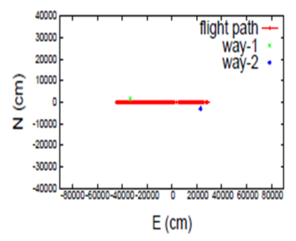
Future extensions to jPapabench
jPapabench
Paparazzi
Notes:
In our first exploration, we have a comparison of the flight path between jPapabench and Paparazzi.
The plane is configured to travel from way-point A to point way-point B.
As the coordinate system for the GPS messages is
North East Down (NED) , for simplicity, we choose to represent
The north and east data in a 2-demisson graph, they can be treatedd as distance
from the initial position in X and Y coordinates.
The current flight model that jPapabench uses is very simplified, it an abstract flight, as you can see in these graphs between two way points.
The plane in Jpapabench directly flies from point A to piont B, while a real flight model powered by dynamic physic simulator is not nearly so precise.
As we can see here in the right figure, the plane need to correct on the physic of the plane, the character of environment, and it is not all to just simply fly from point A to point B.

Slide 20
Future Work on RTDroid
Real-time extension of Android manifest for off-line analysis and resource pre-allocation
Programming model design with scoped memory
Multi-application execution in partitioned system
Alterative of Binder for inter-process communication
Thanks

Slide 21
Visit Us
http://rtdroid.cse.buffalo.edu

Slide 22
Evaluation for RT Sensor Architecture
Application: soft real-time fall detector
Simulated workload:
  Memory intensive load: allocating a 2.5 MB integer array every 20ms
  Computation intensive load: tight loop performing a floating point multiplication every 20ms
Measurement:
the latency of the sensor data delivery
Time cost from the time of sensor data buffered in kernel to the time of the sensor data delivered in application
Notes:
Backup:
Fragment memory and create memory pressure, the extent of fragmentation is dependent on the VM and underlying GC. RTGCs can minimize and in some cases eliminate fragmentation

Slide 23
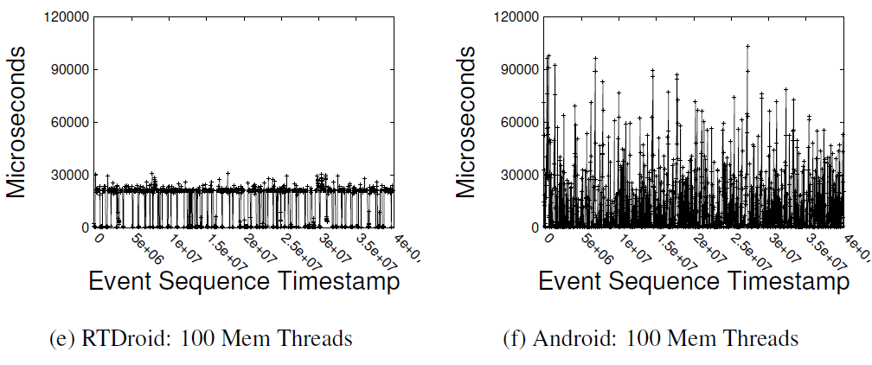
Evaluation for RT Sensor Architecture
RTEMS
Memory stress test for the fall detection app on Nexus S
Notes:
backup

